Slide 1
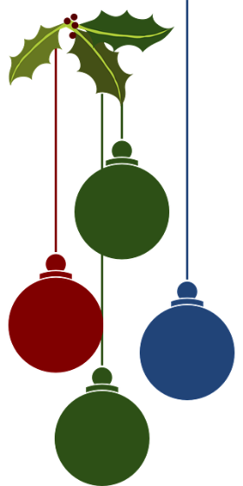
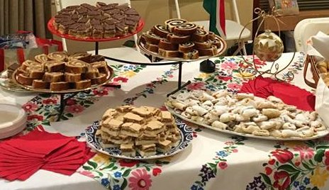
Showcasing Holiday Traditions and Foods from: Aswan, Egypt • Chambolle-Musigny, France Greve in Chianti, Italy • Kaniv, Ukraine Patzcuaro, Mexico • Penglai, China and Tokaj, Hungary Friday, December 2, 2022 6pm – 8pm Burlingame Hall 252 W. Spain Street, Sonoma Free to members $25 for non-members (includes 2023 membership) SILENT AUCTION WINE PULL follow link to register SSCA Holiday Party registration or call (707) 931-1357
Sonoma Sister Cities Association Presents
“Holidays Around the World”

